Slide 1
2D & 3D measuring

Slide 2
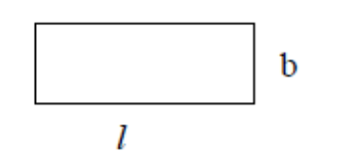

Rectangle

Slide 3


Slide 4


Slide 5
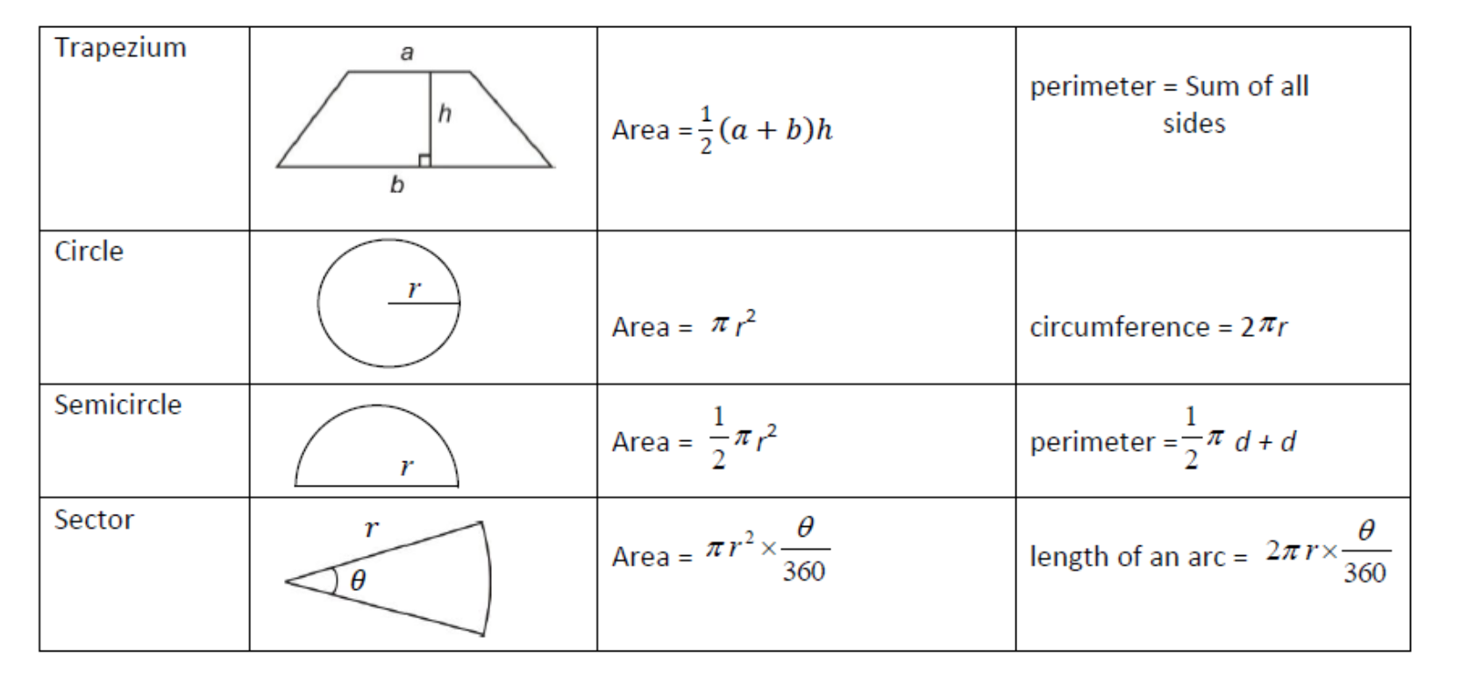

Slide 6
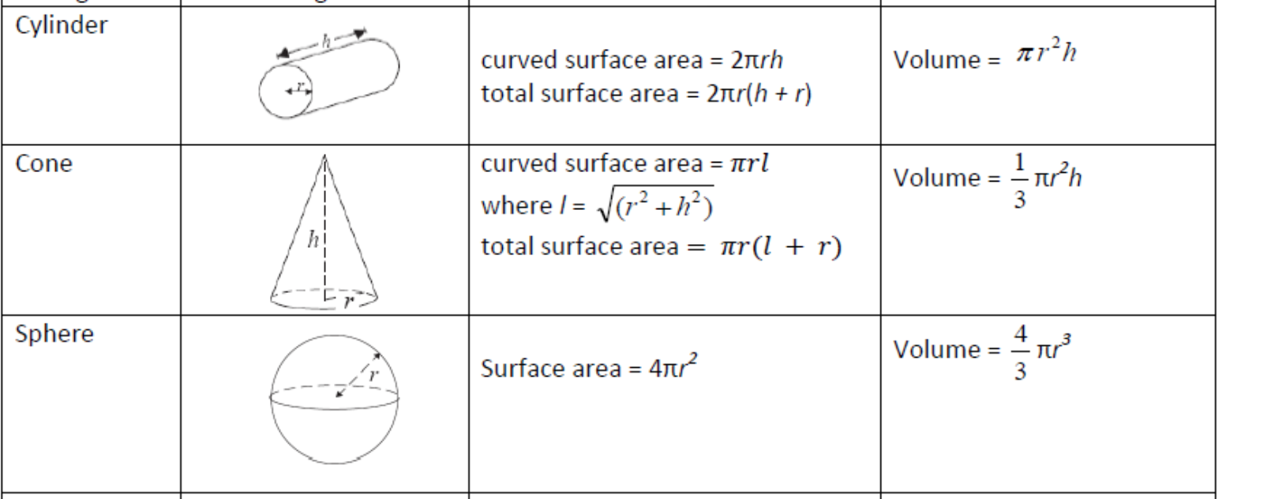

Slide 7
